Slide 1




Food Sovereignty
“from the ground up”
Barren Lands First Nation
Northlands Dënesųłiné
First Nation
Sayisi Dene First Nation
St Theresa Point
First Nation

Slide 2
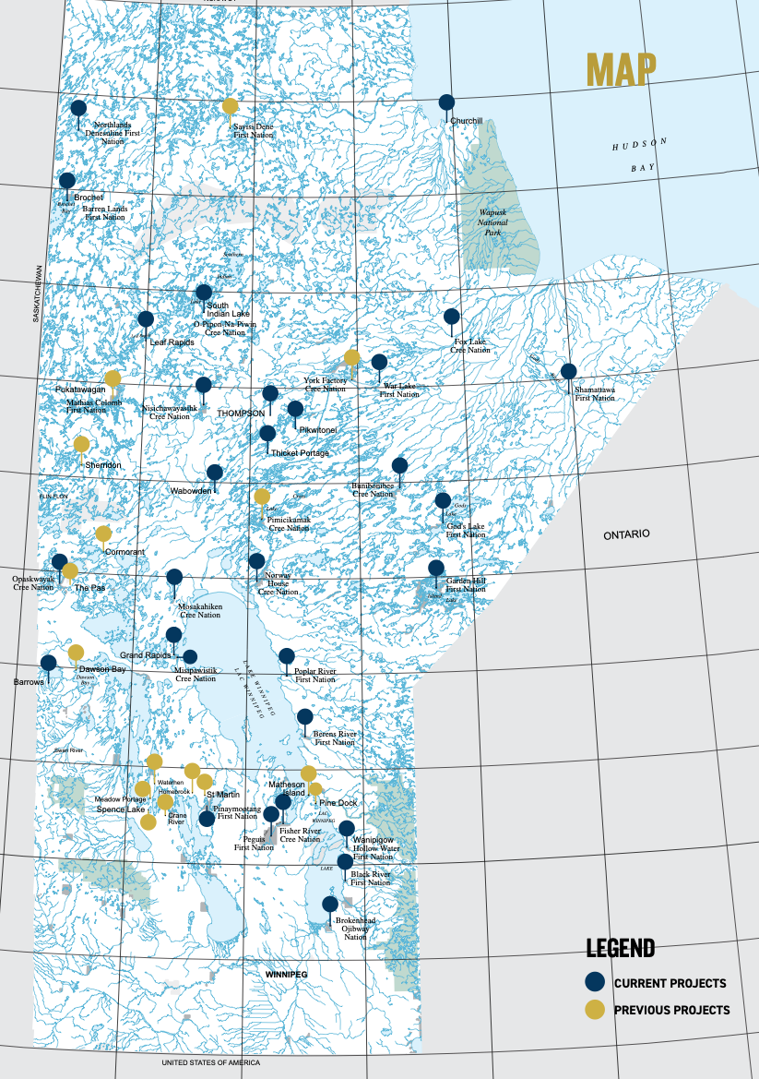
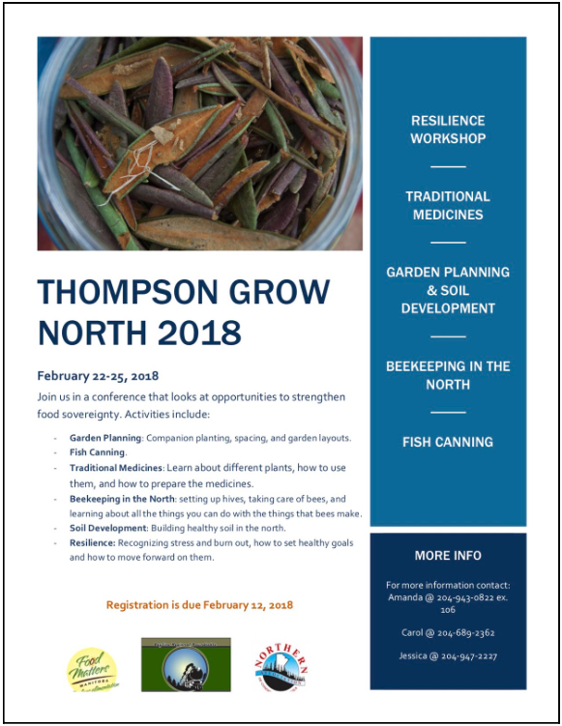
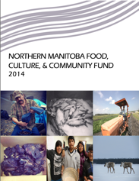
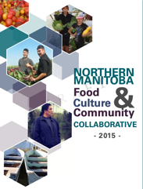
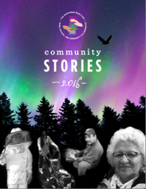
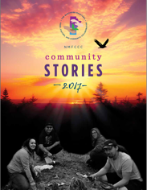
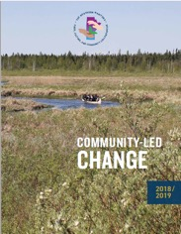
Community
Partner
Stories
2014
2015
2016
2017
2018/19

Slide 3
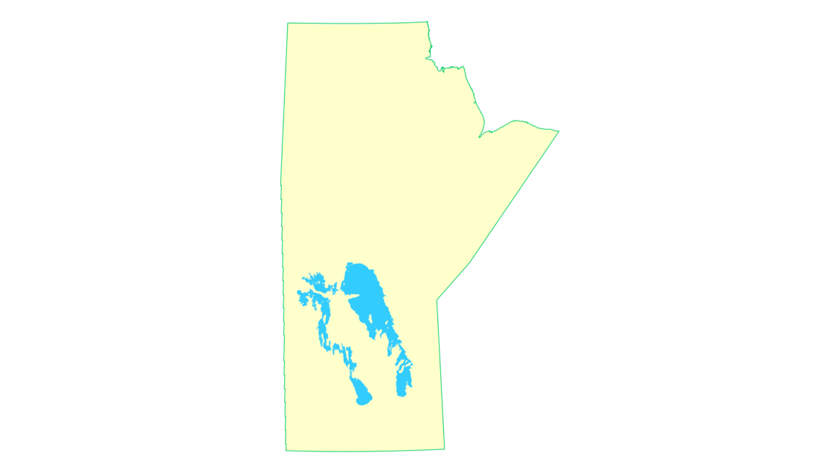

Northlands Dënesųłiné
First Nation
Lac Brochet
Sayisi Dene First Nation
Tadoule Lake
Barren Lands First Nation
Brochet
St Theresa Point First Nation
Island Lake

Slide 4
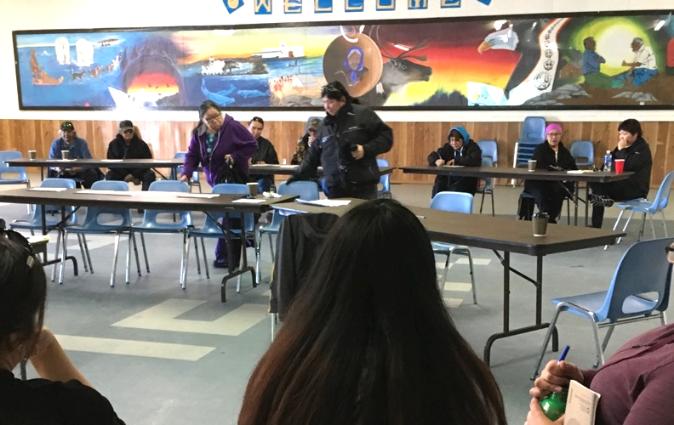
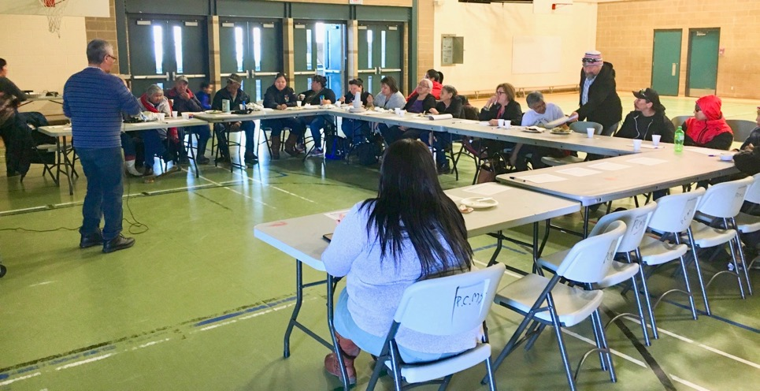
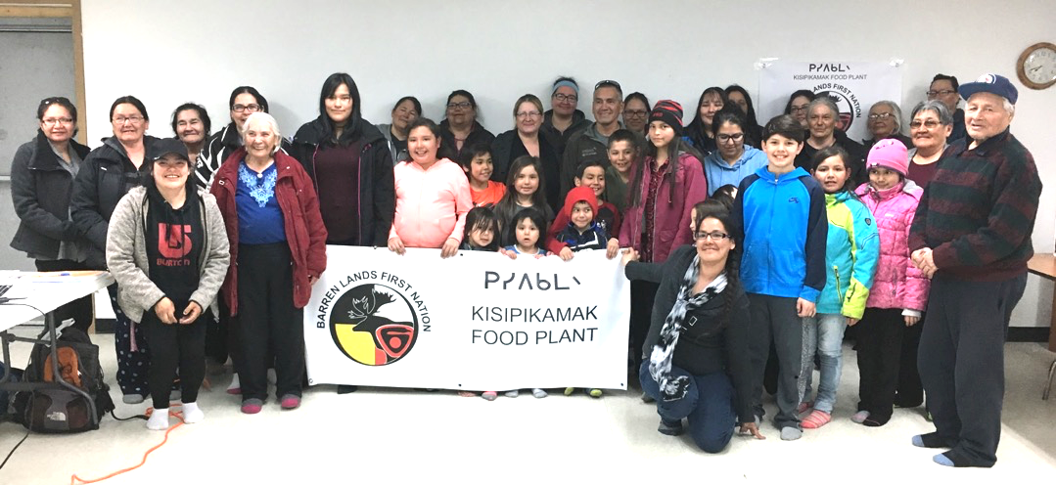
Northlands Dënesųłiné
First Nation
Lac Brochet
Sayisi Dene First Nation
Tadoule Lake
Barren Lands First Nation
Brochet
Northern Food Sovereignty Study Report

Slide 5
Northlands Dënesųłiné
First Nation
Lac Brochet
Sayisi Dene First Nation
Tadoule Lake
Barren Lands First Nation
Brochet
Northern Food Sovereignty Study Report

Slide 6
Food Sovereignty
  a community owns, controls & benefits from its own food systems
  “from the ground up”
    build on
      traditions
      past successes
      sustainable practices
    build only
      things local people can build, maintain & repair
    produce only
      what local people want to eat
“Sovereignty is the full right and power of a governing body over itself, without any interference from outside sources or bodies.”
Wikipedia

Slide 7


community development
Food is one part of a whole.
food
energy
waste
a cluster of activities
flow (usually of tangible things)

Slide 8
food
energy
waste
land-based
education
community development

Slide 9
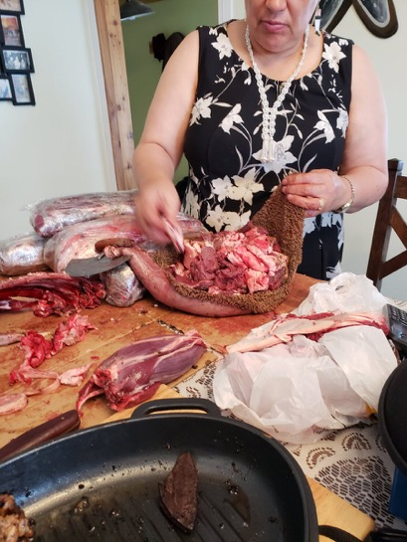
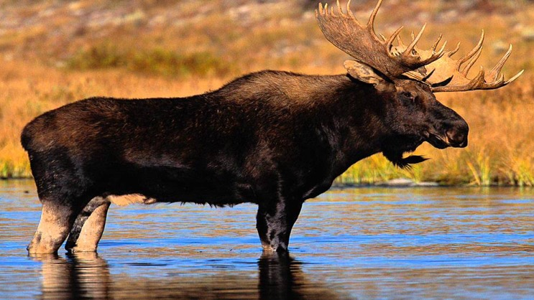
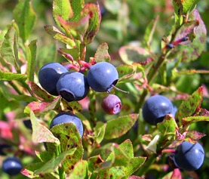
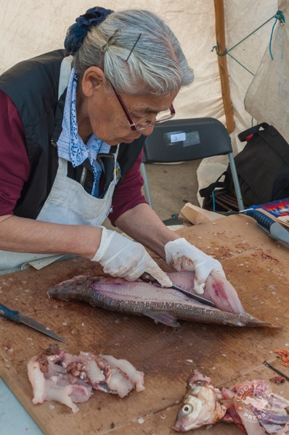
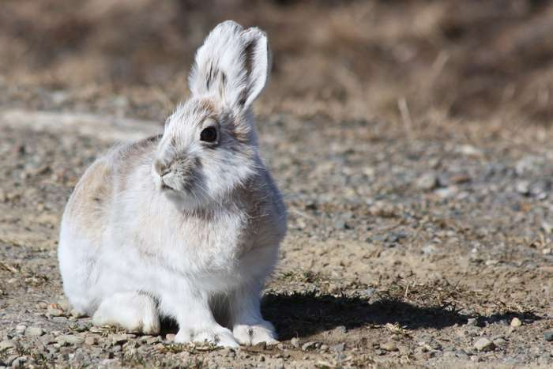
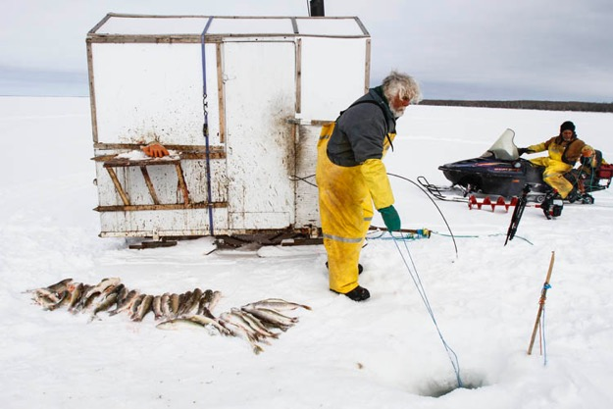
food
hunting
cleaning & dressing
fishing
eating fresh
gathering

Slide 10
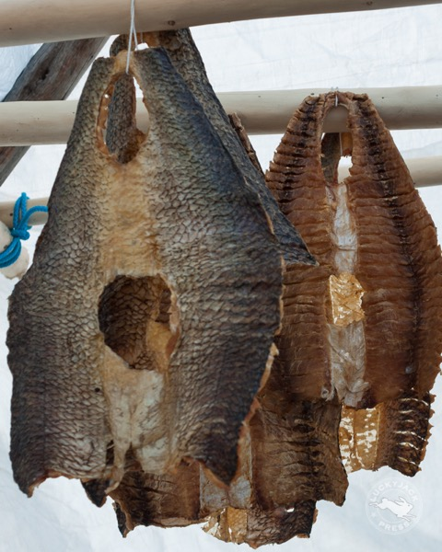
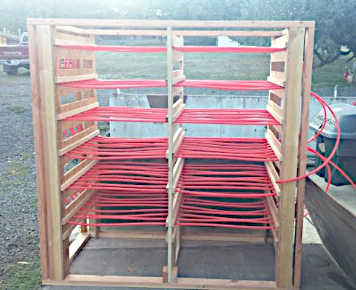
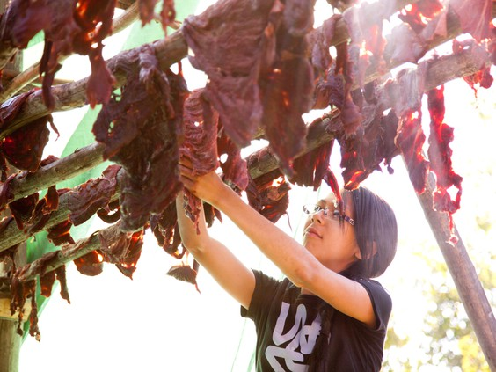
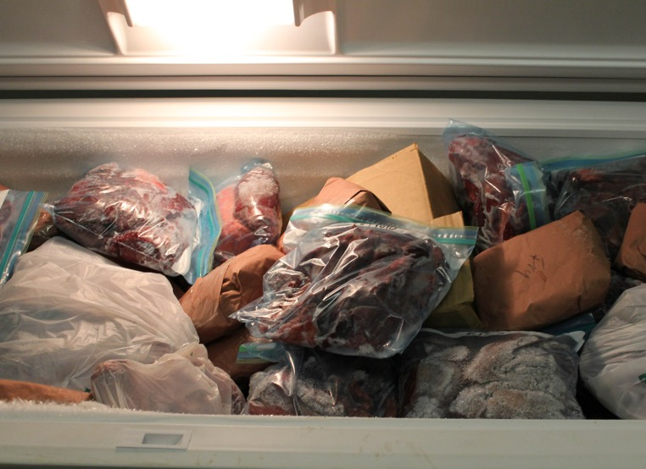
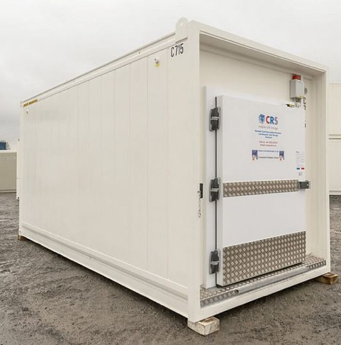
food
hunting
cleaning & dressing
fishing
eating fresh
hydronic dryer
(under construction)
gathering
preserving
flash freezer
drying
smoking
eating later
freezing

Slide 11
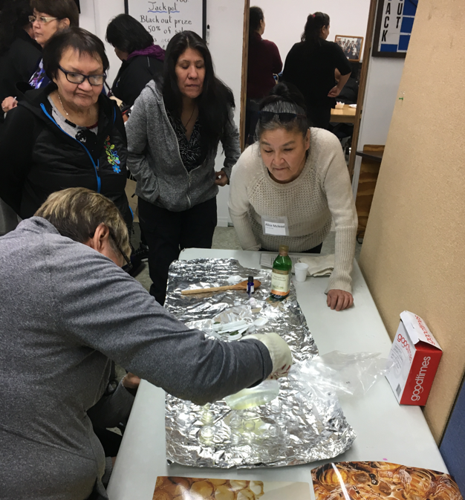
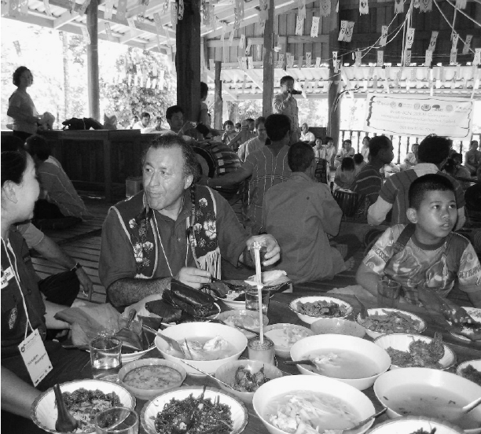
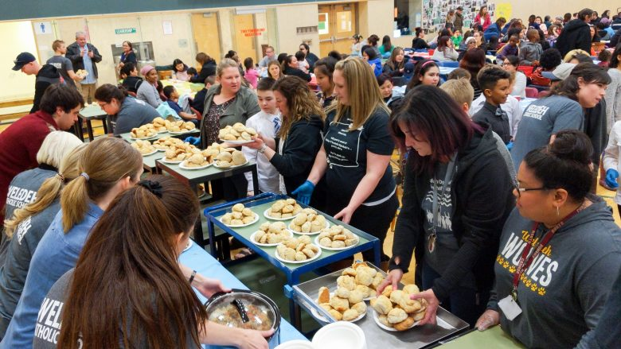
food
hunting
cleaning & dressing
community
fishing
feasting
eating fresh
gathering
gifting
preserving
drying
smoking
eating later
freezing

Slide 12
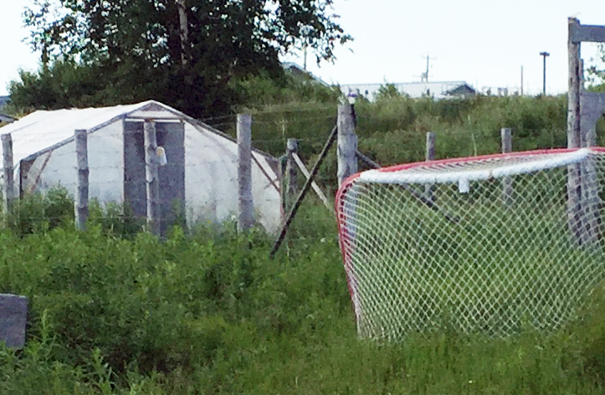
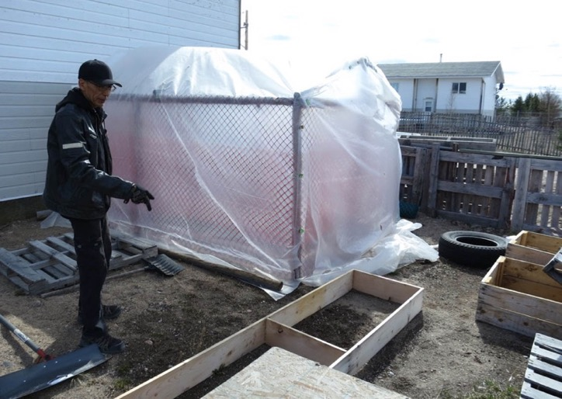
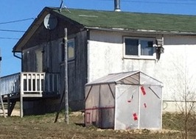
food
hunting
cleaning & dressing
community
fishing
feasting
eating fresh
gathering
gifting
preserving
drying
smoking
eating later
home gardens
freezing
home greenhouses

Slide 13
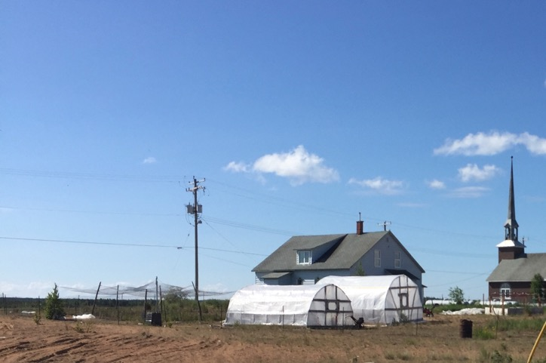
food
hunting
cleaning & dressing
community
fishing
feasting
eating fresh
gathering
gifting
preserving
drying
smoking
eating later
school* garden
home gardens
freezing
school* greenhouse
home greenhouses
*community
Notes:
Top 2 right images Source: http://tidescanada.org/food/community-stories-share-local-food-successes- northern-manitoba/

Slide 14
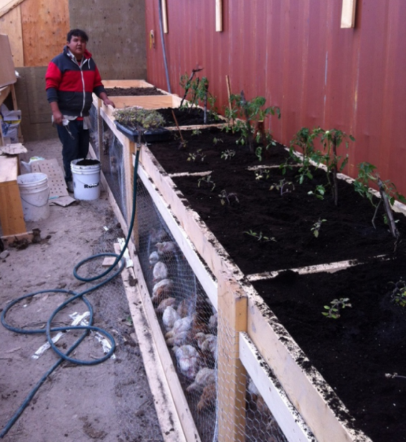
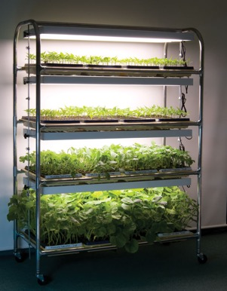
food
hunting
cleaning & dressing
community
fishing
feasting
eating fresh
gathering
gifting
preserving
school* seed-starting
home
seed-starting
drying
smoking
eating later
school* garden
home gardens
freezing
school* greenhouse
home greenhouses
*community

Slide 15
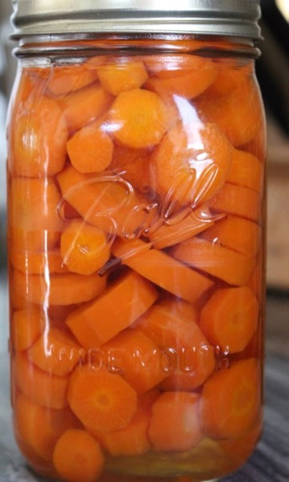
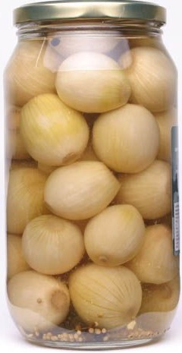
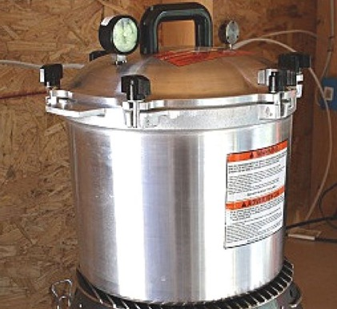
food
hunting
cleaning & dressing
community
fishing
feasting
eating fresh
gathering
gifting
preserving
school* seed-starting
home
seed-starting
drying
smoking
eating later
school* garden
home gardens
freezing
school* greenhouse
home greenhouses
canning
*community

Slide 16
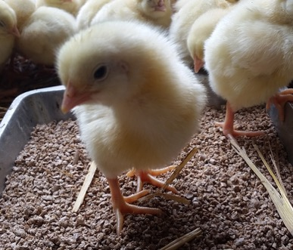
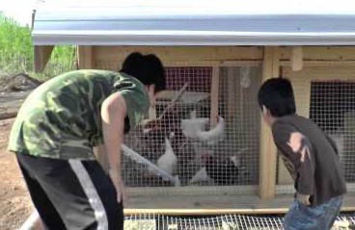
food
raising animals
hunting
cleaning & dressing
chicken coop
community
fishing
feasting
rabbit hutch
eating fresh
gathering
gifting
preserving
school* seed-starting
home
seed-starting
drying
freezing
eating later
school* garden
home gardens
canning
school* greenhouse
home greenhouses
*community

Slide 17
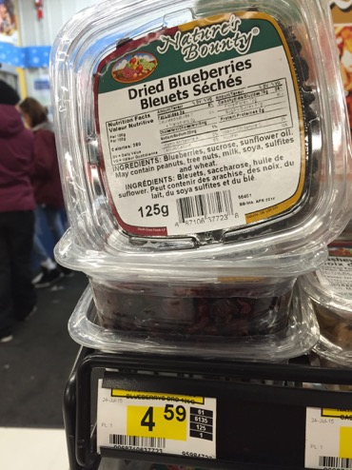
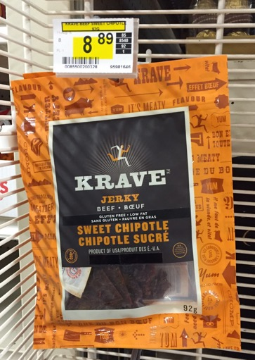
food
raising animals
hunting
cleaning & dressing
chicken coop
community
fishing
feasting
rabbit hutch
eating fresh
gathering
gifting
$37/kg
preserving
selling
school* seed-starting
home
seed-starting
drying
freezing
eating later
school* garden
home gardens
canning
school* greenhouse
home greenhouses
$98/kg
*community

Slide 18
food
raising animals
hunting
cleaning & dressing
chicken coop
community
fishing
feasting
rabbit hutch
eating fresh
gathering
gifting
preserving
selling
school* seed-starting
home
seed-starting
drying
freezing
eating later
school* garden
home gardens
canning
school* greenhouse
home greenhouses
*community

Slide 19
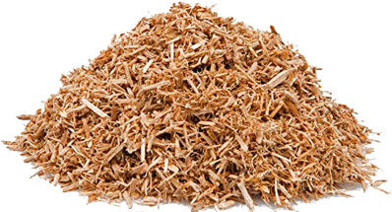
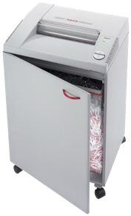
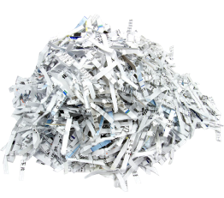
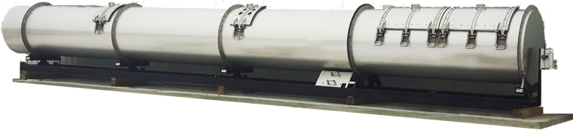
food
seed-starting
cleaning & dressing
chicken coop
wood chips & sawdust
gardens
paper
shredder
rabbit hutch
greenhouses
eating fresh
organic waste
sand
soil
eating later
“overburden”
(moss & other organic materials from clearing land for housing
& other infrastructure)
in-vessel composter
soil amendments?
waste

Slide 20
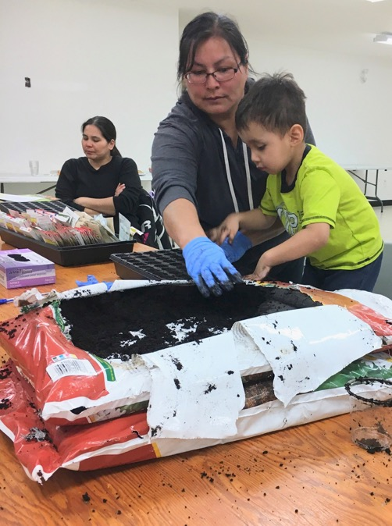
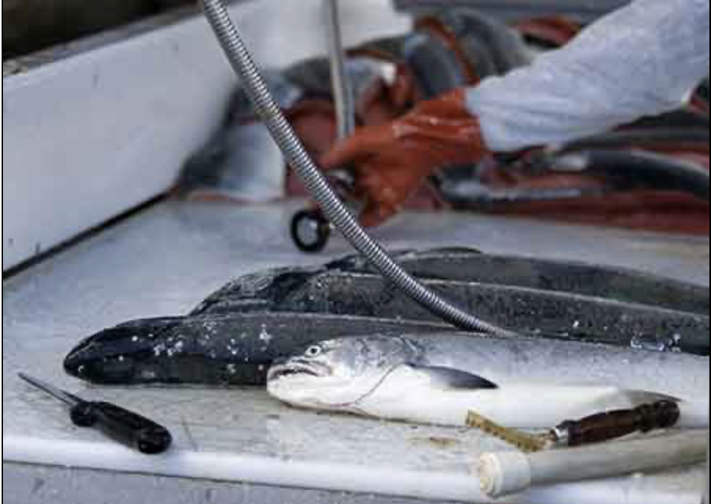
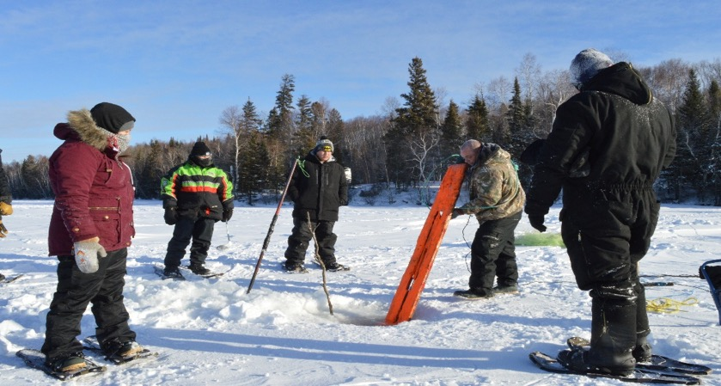
food
waste
land-based
education
Notes:
Gutting fish: https://www.adfg.alaska.gov/index.cfm?adfg=wildlifenews.view_article&articles_id=777

Slide 21
food
energy
waste
land-based
education
community development

Slide 22
Food Sovereignty
5-Year Plans

Slide 23
Barren Lands
Brochet

Slide 24
Northlands Dënesųłiné
Lac Brochet

Slide 25
Sayisi Dene
Tadoule Lake

Slide 26
To Make This Happen…
need 2 infusions of funds
  “capital”
    for equipment & materials
      can go up on this year’s winter road
    primarily from
      federal government
  ongoing
    for
      a food champion in each community
      consumables
    now primarily from
      provincial government
      foundations

Slide 27
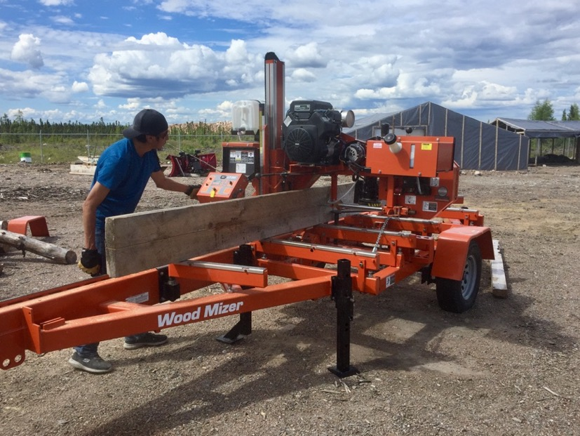
“Capital” Expenditures
shipping container of soil
in-vessel composter
paper shredder
materials for
  raised growing beds
  small greenhouses
  fences
  benches
  ice-fishing shacks
  food dehydrators
  smokers
flash freezer
small sawmill

Slide 28
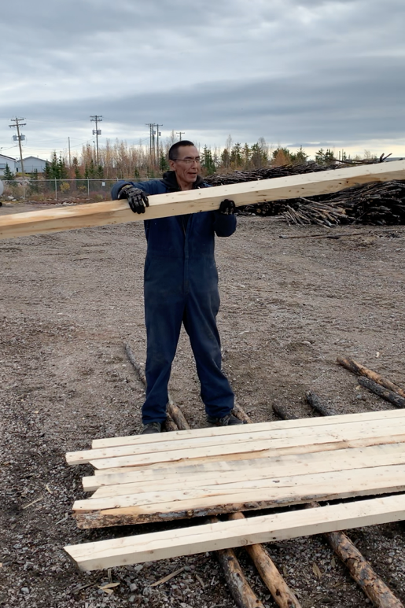
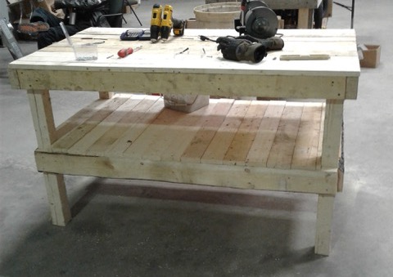
“Capital” Expenditures
shipping container of soil
in-vessel composter
paper shredder
materials for
  raised growing beds
  small greenhouses
  fences
  benches
  ice-fishing shacks
  food dehydrators
  smokers
flash freezer
&
woodworking equipment
small sawmill

Slide 29
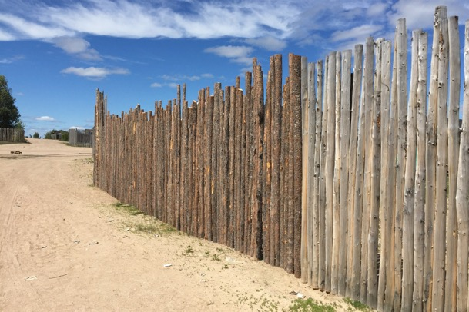
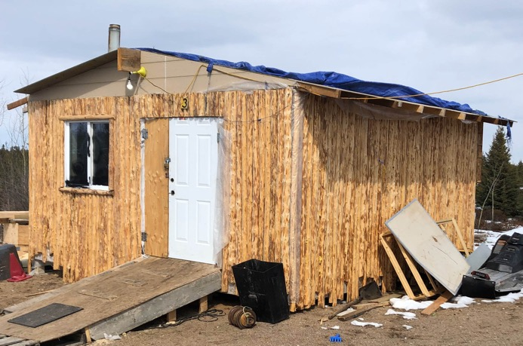

“Capital” Expenditures
shipping container of soil
in-vessel composter
paper shredder
materials for
  raised growing beds
  small greenhouses
  fences
  benches
  ice-fishing shacks
  food dehydrators
  smokers
flash freezer

Slide 30


“Capital” Expenditures
shipping container of soil
in-vessel composter
paper shredder
materials for
  raised growing beds
  small greenhouses
  fences
  benches
  ice-fishing shacks
  food dehydrators
  smokers
flash freezer

Slide 31


“Capital” Expenditures
shipping container of soil
in-vessel composter
paper shredder
materials for
  raised growing beds
  small greenhouses
  fences
  benches
  ice-fishing shacks
  food dehydrators
  smokers
flash freezer

Slide 32

“Capital” Expenditures
shipping container of soil
in-vessel composter
paper shredder
materials for
  raised growing beds
  small greenhouses
  fences
  benches
  ice-fishing shacks
  food dehydrators
  smokers
flash freezer
cleaning & dressing facility
  fish shack plus…
    bird plucking & cleaning
    animal carcass processing
    refrigerated storage
hunting & net-fishing equipment
canning equipment
water cistern
electric runabout (side-by-side) & trailer
bobcat
snowmobile

Slide 33
Anticipated Results
    > 20 households in each community grow their own vegetables
    double local, healthy food in diet
    land-based education core part of school curriculum
      hunting, fishing gardening & preserving skills passed on to next generation
    majority of organics diverted from waste stream

Slide 34











Flow of Funds & Supports
community team
Northern Healthy
Foods Initiative
community team
community team
community team
foundations
sustainable
food
veterans
support team

Slide 35
Food Sovereignty
“from the ground up”
Barren Lands First Nation
Northlands Dënesųłiné
First Nation
Sayisi Dene First Nation
St Theresa Point
First Nation

Slide 37
Treaty 5
Sayisi Dene First Nation
Tadoule Lake
St Theresa Point First Nation
Island Lake

Slide 38
Treaty 10
Northlands Dënesųłiné
First Nation
Lac Brochet
Barren Lands First Nation
Brochet

Slide 39

Treaty 5
Sayisi Dene
St Theresa Point
“It is further agreed between Her Majesty and the Indians that the amount of $500 per year shall be spent by Her Majesty in the purchase of ammunition and twine for nets for the use of the Indians.
It is further agreed between Her Majesty and the Indians that the following shall be supplied to any band who are now cultivating the soil: two hoes (tool to clear soil) for every family; one spade (like a shovel) per family; one plough for every ten families; five harrows (ploughs the ground) for every twenty families; one scythe (cuts plants and grass) for every family.
Each band would receive one axe; one cross-cut saw; one hand-saw; one pit-saw; sharpening files; one grindstone; and one auger.
Each Chief would receive for use of his band: one chest of carpenters tools; enough wheat, barley, potatoes and oats to plant the land; one yoke of oxen; one bull; four cows to encourage the practice of agriculture among the Indians.”

Slide 40
Treaty 10
Northlands Dënesųłiné
Barren Lands
“His Majesty agrees to furnish such assistance as may be found necessary or advisable to aid and assist the Indians in agriculture or stock-raising or other work and to make such a distribution of twine and ammunition to them annually as is usually made to Indians similarly situated.”

